Slide 1

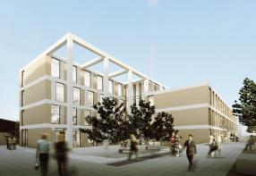
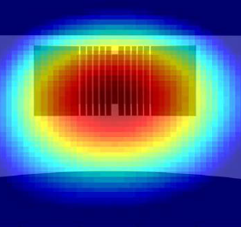
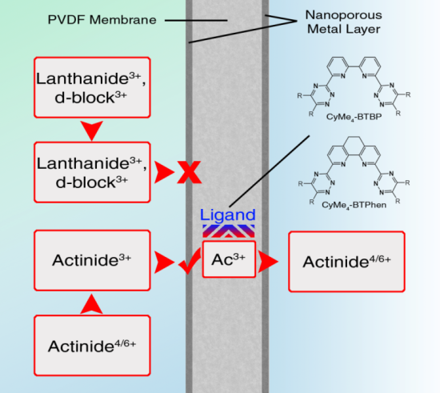
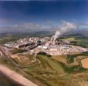
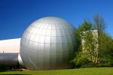
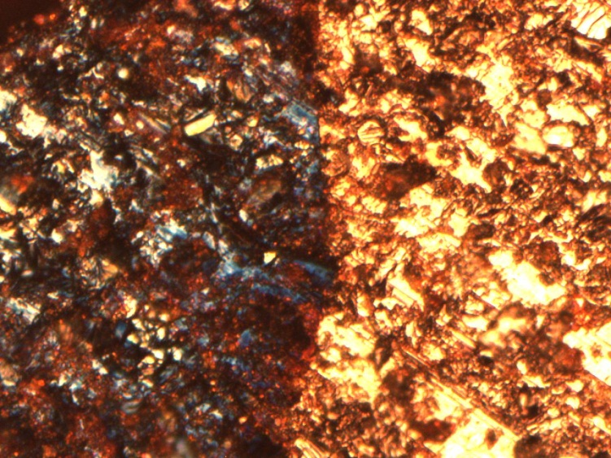
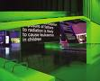
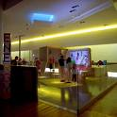
Nuclear R&D at Lancaster
Professor Colin Boxall,
Lloyd’s Register Foundation Chair in Nuclear Engineering & Decommissioning

Slide 2
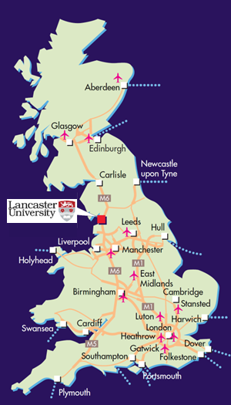
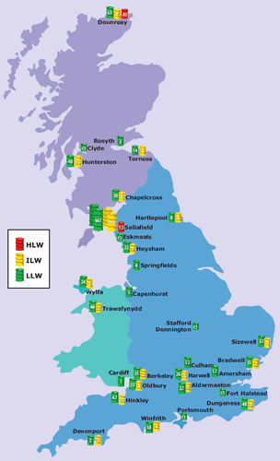
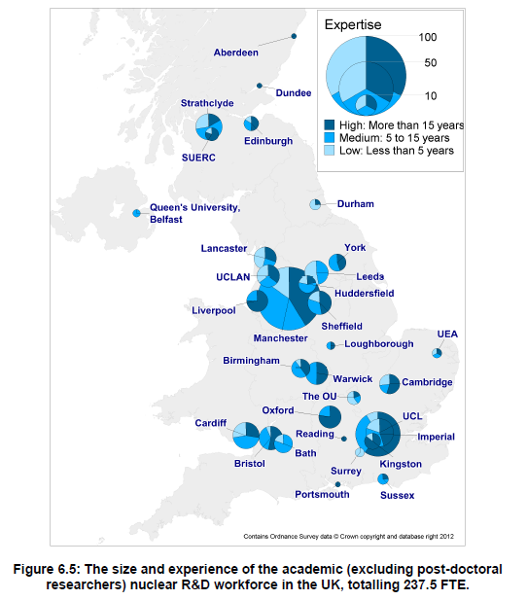
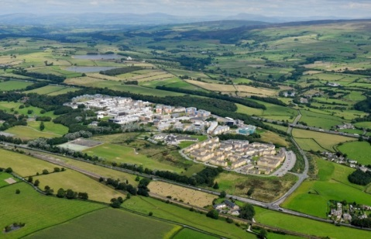
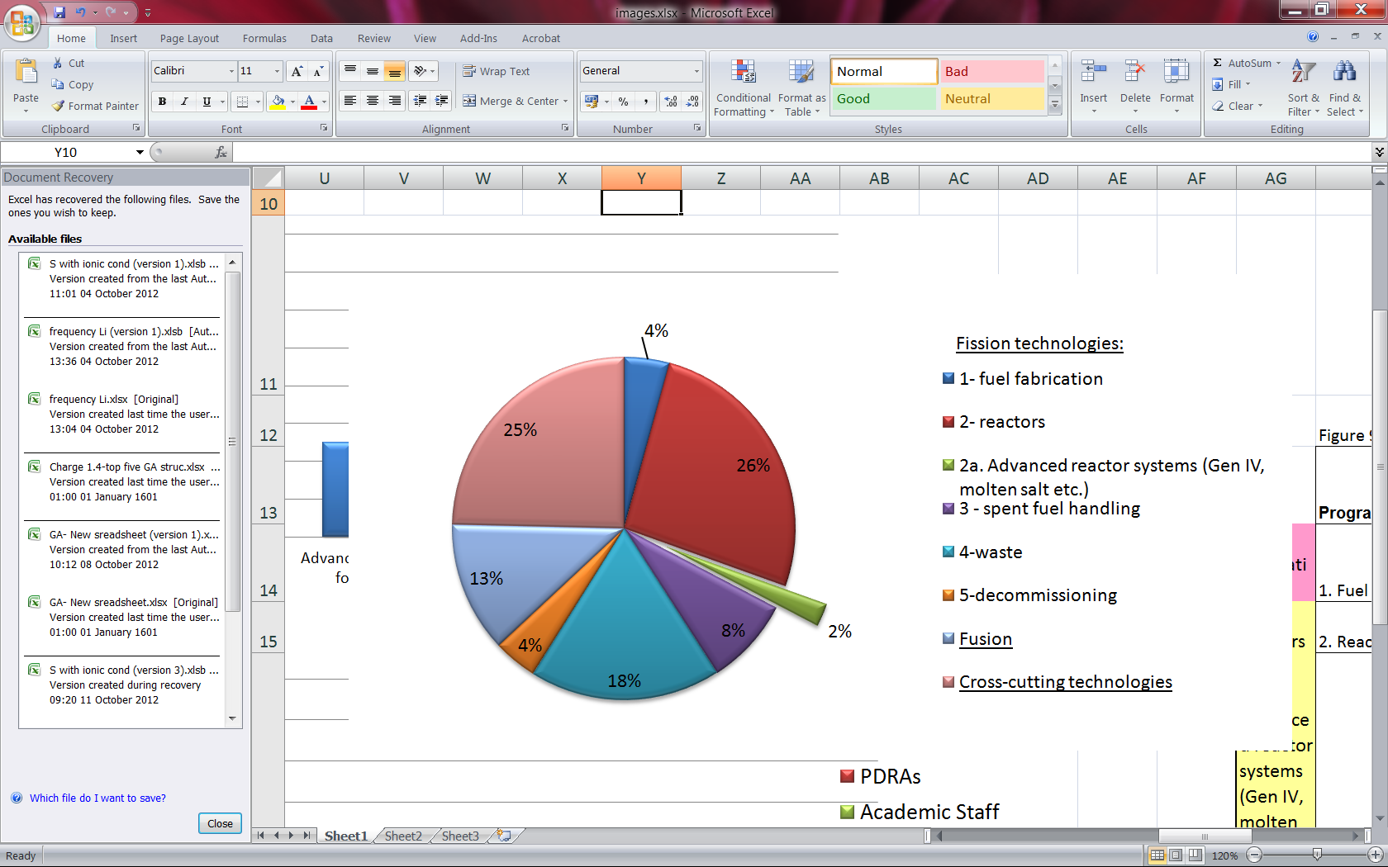
Nuclear at Lancaster - Overview
Nearly 20 years of teaching & research
Closest research intensive main campus to Sellafield
4 Professors, 9 lecturers across 3 depts inc. Engineering & Lancaster Environment Centre
Nearly 40 PDRA/PGRS in nuclear
UG programmes in Nuclear Engineering, Chem Eng, Mech Eng
Industrial MSc in Nuclear Decommissioning
Home to Lloyds Register Foundation Centre for Nuclear Engineering & Decommissioning
UTGARD Lab (Uranium/Thorium beta/Gamma Active R&D Lab)
Part of NNUF – host to ADRIANA facility
Next Generation Nuclear Centre for Doctoral Training with Manchester, Liverpool, Leeds and Sheffield Universities
SACSESS, DISTINCTIVE, PACIFIC, UK-SNF
new £12.5M Engineering Building in 2015
Notes:
AOT = advanced oxidation technologies
SRS = Savannah River Site

Slide 3
Nuclear at Lancaster - Overview
Nearly 20 years of teaching & research
Closest research intensive main campus to Sellafield
4 Professors, 9 lecturers across 3 depts inc. Engineering & Lancaster Environment Centre
Nearly 40 PDRA/PGRS in nuclear
UG programmes in Nuclear Engineering, Chem Eng, Mech Eng
Industrial MSc in Nuclear Decommissioning
Home to Lloyds Register Foundation Centre for Nuclear Engineering & Decommissioning
UTGARD Lab (Uranium/Thorium beta/Gamma Active R&D Lab)
Part of NNUF – host to ADRIANA facility
Next Generation Nuclear Centre for Doctoral Training with Manchester, Liverpool, Leeds and Sheffield Universities
SACSESS, DISTINCTIVE, PACIFIC, UK-SNF
new £12.5M Engineering Building in 2015
Notes:
AOT = advanced oxidation technologies
SRS = Savannah River Site

Slide 4
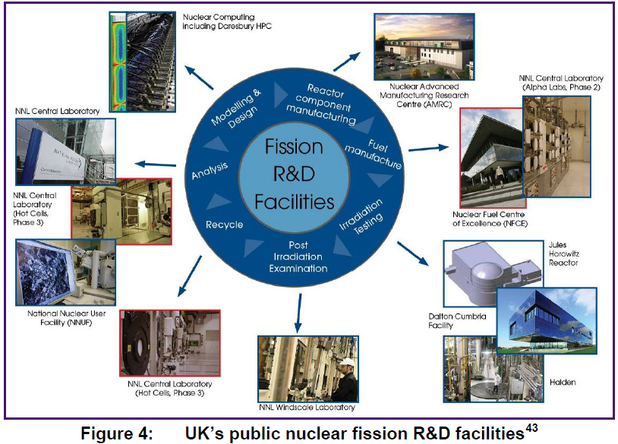
Investment in Facilities: ADRIANA Advanced Digital Radiometric Instrumentation for Applied Nuclear Activities
3rd Party Access
£60M, DECC, BIS, EPSRC

Slide 5




EPSRC Centres for Doctoral Training “Next Generation Nuclear” - NGN
2014-2022: 80 PhD students
£5.7M from EPSRC, £4.8M from Industry, £5.7M from HEIs
Bespoke taught programme
No specific nuclear background required
12 weeks ‘Introduction to Nuclear Energy’
Business Games, Exercises, Case Studies
Strong ‘real life’ contribution
6 months project specific training
36 months PhD research
‘Masterclasses’
‘Whole CDT Events’
‘Winter School’
Steps towards SQEP status
Cosupervision
‘Associate’ students-
Elements of the CDT programme
Industry, DTA, Industrial CASE, NERC funding
8 Industry Partners
Amec
Areva
AWE
EDF Energy
NDA
NNL
Rolls-Royce
Sellafield Ltd
‘Core’ students-
Full CDT programme
Industry, University, EPSRC funding

Slide 6
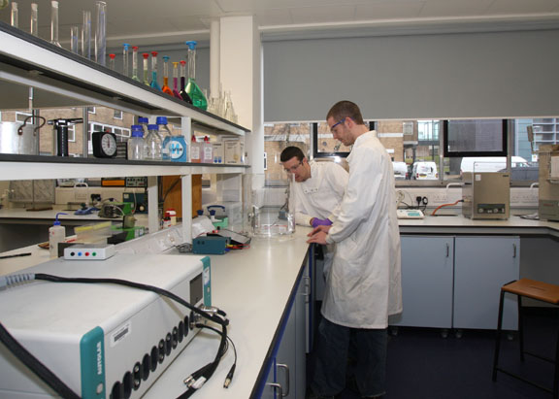
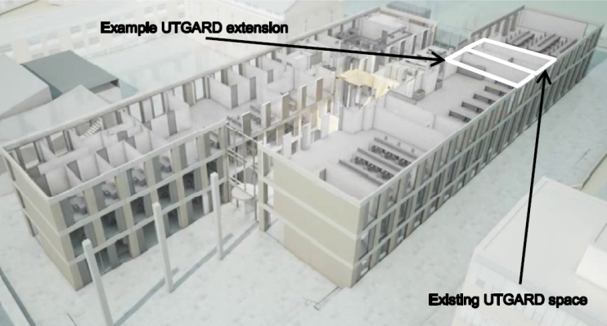
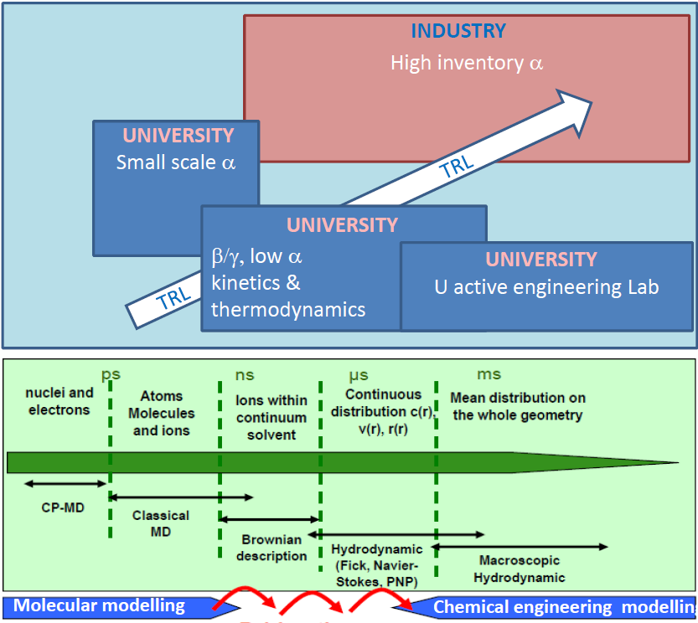
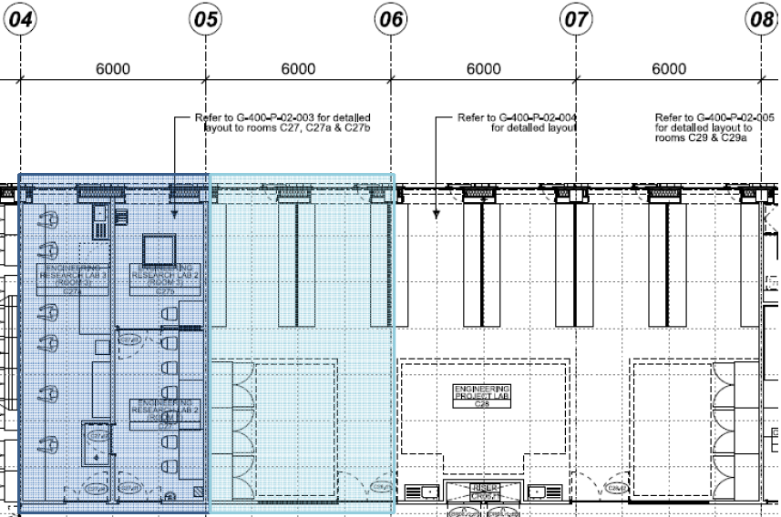
UTGARD Lab U/Th β-Gamma Active R&D Lab
Uranium / thorium active
NIRAB / DECC
External users through NNUF
+ve / -ve P glove boxes, SEM/EDX, γ spectroscopy, UV-vis, Raman microscopy, FT-IR/Raman, HPLC, IC, TGA, centrifugal contactors, electrochemical workstations …

Slide 7













Theme 4
Cross Cutting Technologies

Slide 8

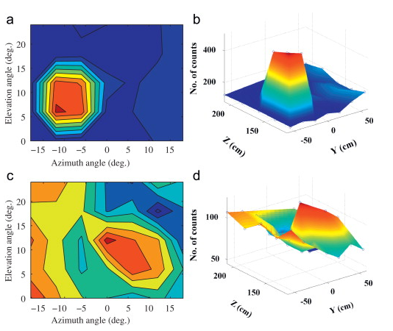
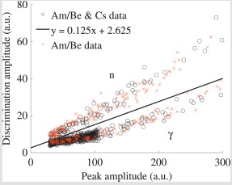
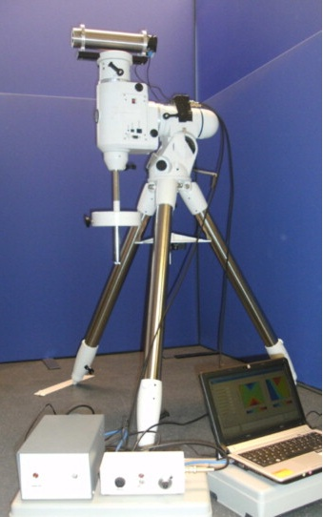
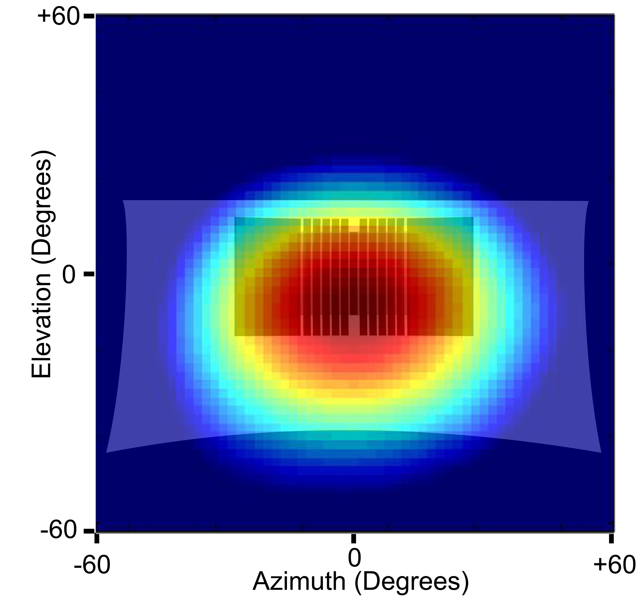
Mixed-field imaging
Fast neutron imaging, organic scintillators, fast digital electronics
Mixed field imaging, depth profiling, collimated for 2D spatial discrimination,
‘Combined digital imaging of mixed-field radioactivity with a single detector’, K. Gamage et al., Nuclear Instruments and Methods in Physics Research, (2010) A635 (1) , pp. 74-77

Slide 9





Theme 3
Decommissioning

Slide 10

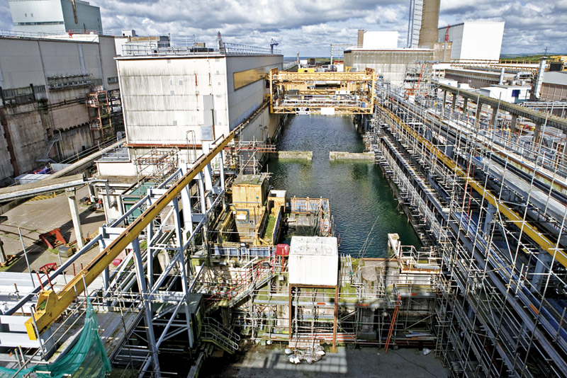
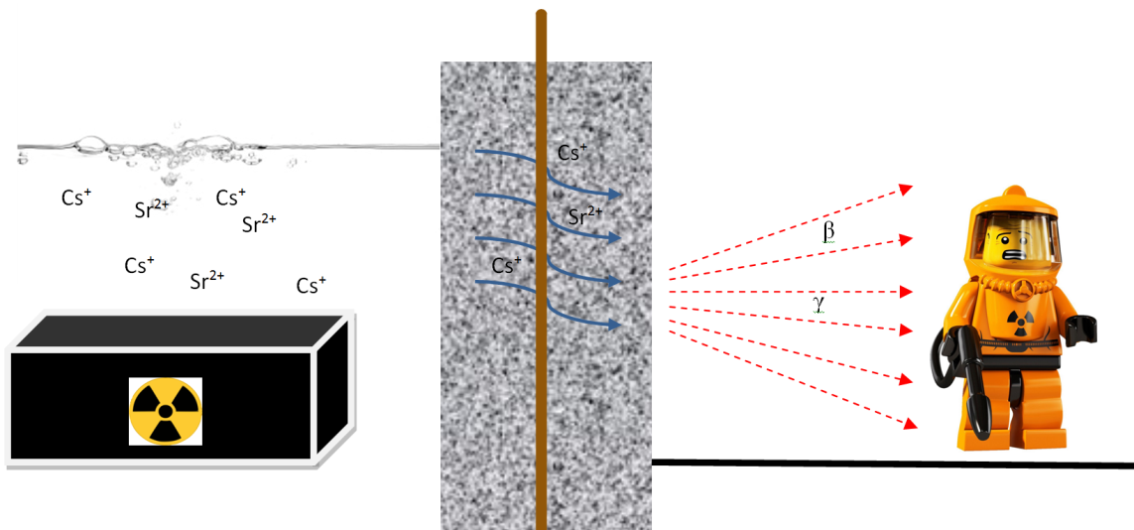
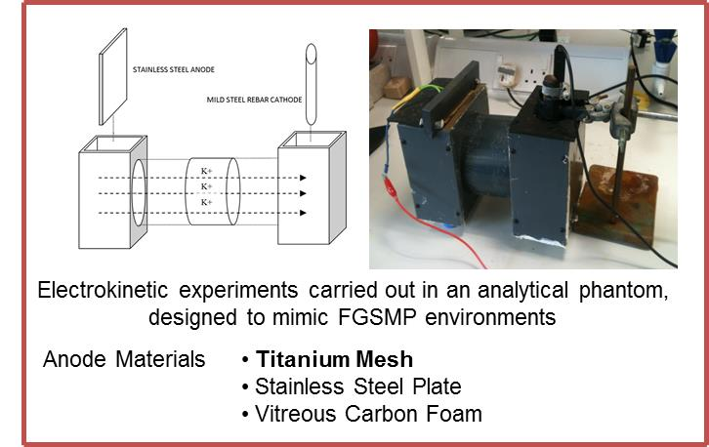
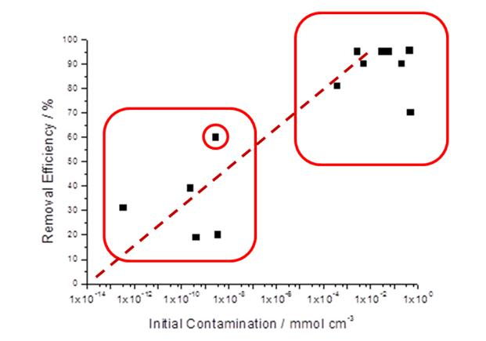
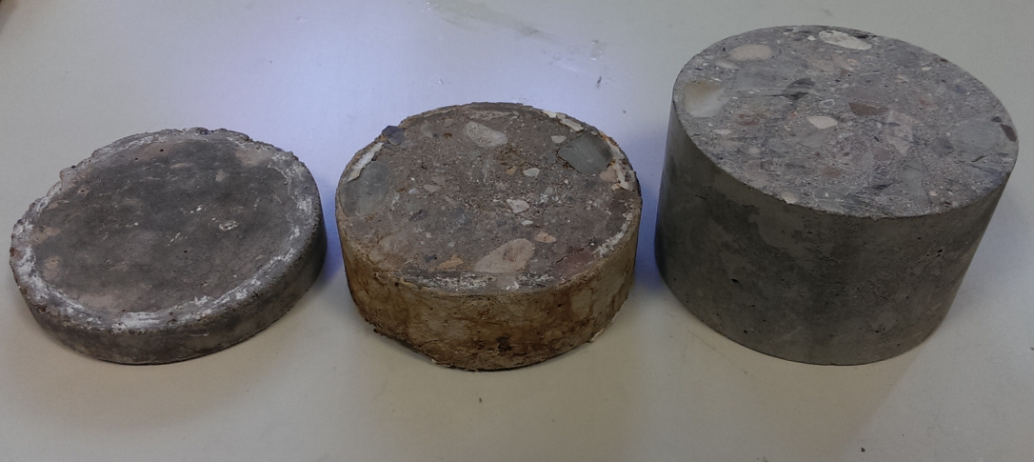
Electrokinetic Decontamination of Concrete
Of UK’s 120 ktonnes of ILW, ~650,000 m³ is contaminated structural concrete.

Slide 11
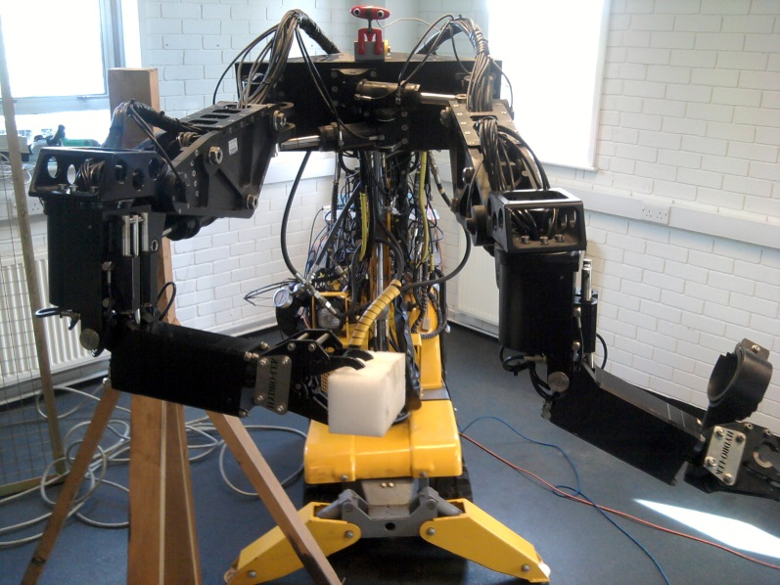
Tele–operated & Autonomous Mobile Robotics for Nuclear
Group: 8 students, 3 academic researchers
Statistical modelling and optimal control
Multidisciplinary approach
widespread impact across academic and industry–based users
funded by EPSRC, ERDF, NDA & industry
applied work spans robotics, transport, energy and the environment
Selected Outputs
Led development of control systems for Mobile Dual–Arm Nuclear Decommissioning Robot, supported by Brokk and HydroLek Ltd and e.g. utilised by NNL and Sellafield for contaminated material discrimination trials (2012)
Taylor, C.J. and Robertson, D. (2013) State–dependent control of a hydraulically–actuated nuclear decommissioning robot, Control Engineering Practice, 21, pp. 1716–1725
Taylor, C.J. & Seward, D.W. (2010) Dual–arm robotic manipulator, Nuclear Engineering International magazine, August, pp. 24–26
Led development of world first on–site Automated Ground Compactor piloted at construction sites in Leeds and Liverpool by Bachy Soletanche

Slide 12




Theme 2
Waste

Slide 13






TRLs 1-3: DISTINCTIVE, 2014-2017
Decommissioning, Immobilisation and Storage Solutions for Nuclear
Waste Inventories
Came from EPSRC call for proposals from consortia in the area of
“Decommissioning, Immobilisation & Management of Nuclear waste”
£5m from EPSRC over 4 years (~£8m inc industry / HEI match)
30 Projects: 20 PhD, 10 Postdoctoral
4 Work Packages
AGR, Magnox & Exotic Spent Fuels
PuO₂ and Fuel Residues
Legacy Ponds & Silo Wastes
Structural Integrity
Industry had key role in selecting projects; TRLs 1-3
Costs shared
PDRAs – EPSRC
PhDs – NDA, NNL, Sellafield, Universities

Slide 14




Theme 1
Spent Fuel

Slide 15
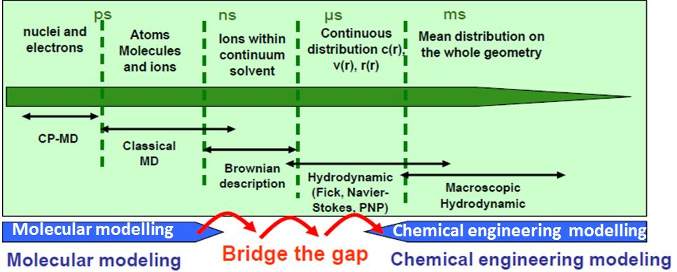
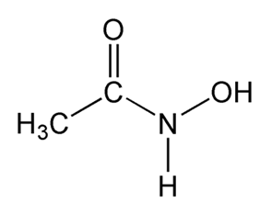
Advanced PUREX (COEX / UREX-like)
HAF
Dissolved SNF
HNO₃
30% TBP
n-dodecane
Extract
Scrub
Target: ~100% Np extraction
Am,Cm,FP
U/Pu Partition
AHA, HNO₃
Complexant based
U-Np-Pu co-stripping
U-Np-Pu
U/Pu ~1
Dil. HNO₃
Simplified PUREX.
Single cycle SX flowsheet
Np control
In a single stream
With Pu-U product
With U then separated
Minor actinide seps
require additional
SX cycles on HLW;
FPs to vitrification
Pu(IV), Np(IV)
complexed
and/or reduced by
XHA – Aqueous
U-backwash
U (Tc)

Slide 16

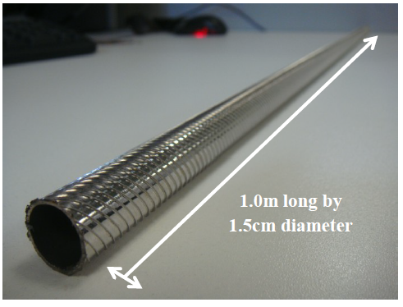
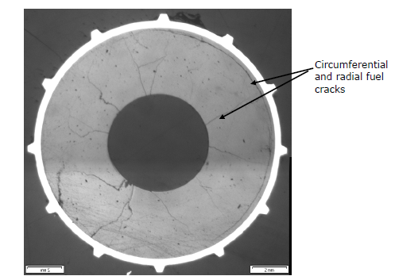
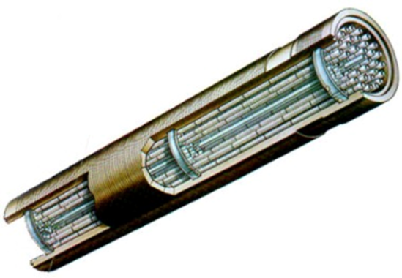
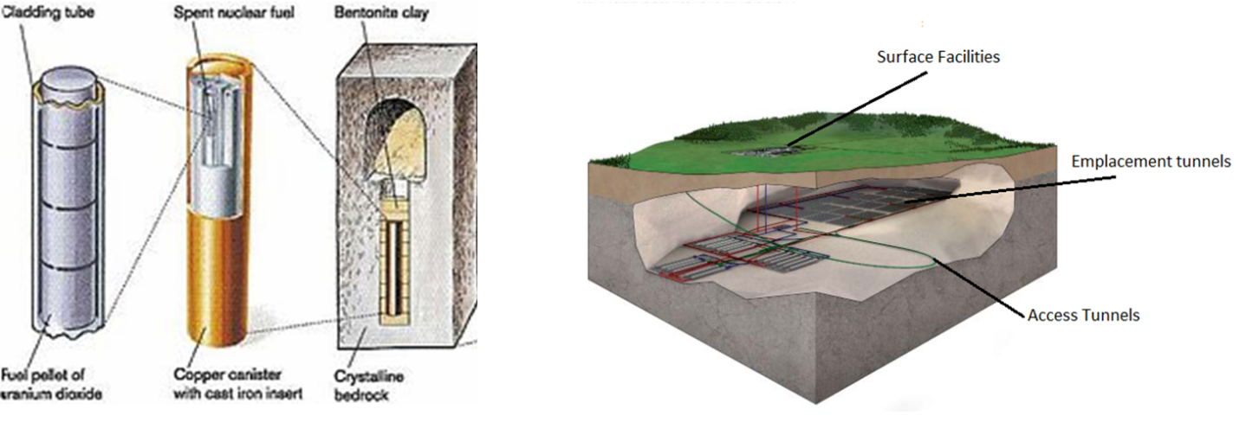
Behaviour of UK SNF Under Conditions Relevant to Geological Disposal
Internationally: Vast majority of UO₂-based SNF is from light water moderated reactors (LWRs)
In UK: AGR reactors - 2-4% enrichment UO₂ ceramic pellets in steel cladding, CO₂ coolant
Significant research conducted internationally on LWR SNF disposal, especially interaction of the UO₂, and its cladding, with groundwaters
Thus, AGR SNF needs to be studied to satisfy safety case requirements before sent to GDF
Cross-section of fuel pin
Annular UO₂ fuel pellet 20/25/Nb Stainless Steel Cladding Complete AGR fuel element

Slide 17



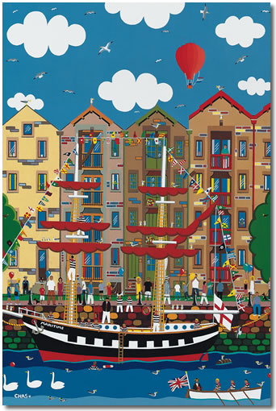




THANK YOU AND QUESTIONS?

